Slide 1
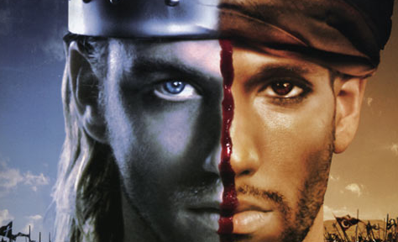
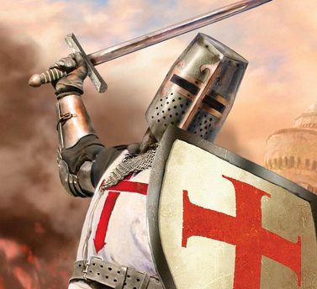
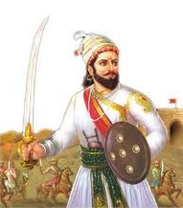
The Crusades
Year 8 History - Medieval Europe

Slide 2

Learning Goals...
Our Goal is to:
Understand what the Crusades were
Why the Crusades happened
Identify significant individuals of the Crusades

Slide 3
The City of Jerusalem...
To understand the Crusades, you must understand that the city of Jerusalem is very important to both Christians and Muslims all around the world. But Why?
For Christians | For Muslims
Jerusalem is the most holy of places for Christians because Jesus was born nearby in Bethlehem and spent most of his life in Jerusalem. Jesus was also crucified in Jerusalem Christians are also known to refer to Jerusalem as “The City of God” | Muhammad, the founder of the Muslim Faith - Islam, had visited Jerusalem on a pilgrimage Muhammad is believed to be the messenger of Allah, the Muslim God. Muslims believe that Muhammad ascended to heaven, while at the Dome of the Rock in Jerusalem, and met Allah who told him the 5 pillars of Islam.

Slide 4
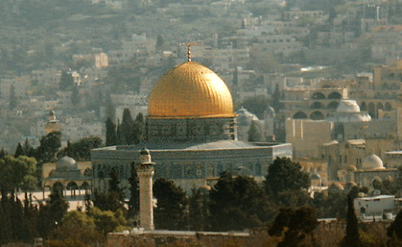
RESEARCH ACTIVITY
Q: Research the Dome of the Rock to discover why it is important to both Christian and Muslim people. You can create a table to explain your answer if you wish.
The Dome of the Rock is the oldest existing Islamic monument. It was taken over by Crusaders and turned into a Christian Shrine before being returned to Islamic control.

Slide 5
The Crusades
During the 11th century, Muslims had captured the city of Jerusalem and had begun to attack Christian people who were on pilgrimages to the Holy Land.
In response to this, the Pope (Urban II) rallied all Christians from across Europe to fight for control of Jerusalem and take back the Holy Land from the Muslims. This was start of the Crusades.
The Crusades were a series of wars between Christians and Muslims between 1096 - 1291 AD. We will focus on the First (1096-1099 AD) and Third Crusades (1189-1192 AD).

Slide 6
The First Crusade
Some of the first Christian Crusaders were knights. The knights believed that by taking part in a crusade to return the Holy Land to Christian control it would gain them entry into heaven.
Other knights were simply looking for adventure, to get rich or to even gain more power when they returned home.
Thousands of peasants also participated in the Crusades by following a monk who was called “Peter the Hermit”.

Slide 7
The First Crusade
After a long journey over land and series of bloody battles, the knights eventually captured Jerusalem.
The knights murdered all the muslims and jews in the city of Jerusalem. They felt justified in doing this, and that they were acting in God’s name, because of the all the Christians that were killed earlier on pilgrimages.
The knights went on to set up The Knights Templar. A group of knights who were charged with the duty of protecting Christians on pilgrimages to the Holy Land.

Slide 8
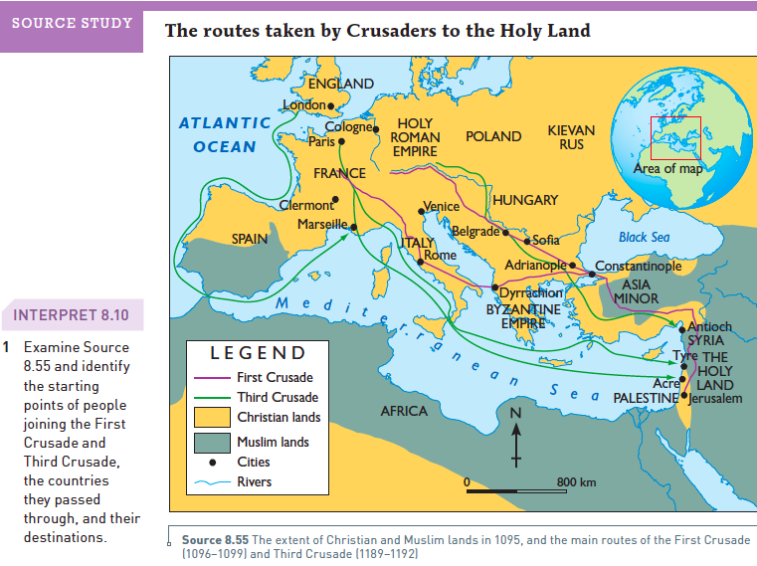
Source Study
Attempt this question in your workbook.

Slide 9
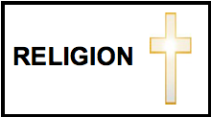
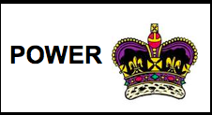
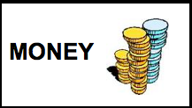
COMPREHENSION
In what years did the First Crusade take place?
Write the definition of the terms Crusades and Pilgrimage in your workbook.
Complete the Reasons “To Go On A Crusade” activity in your workbook by creating a table with the columns Religion, Power and Money. Example:
Then, write the Reasons (on the next slide) under the correct column heading.

Slide 10



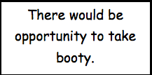
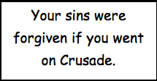


REASONS TO GO ON A CRUSADE

Slide 11
COMPREHENSION
4) Explain what happened when the knights of the First Crusade arrived in Jerusalem.
5) What do you think? Was it right for the knights to do what they did to the jews and muslims of Jerusalem? Can you suggest any other alternatives?
6) How many years are between the First Crusades and the Third Crusades?

Slide 12
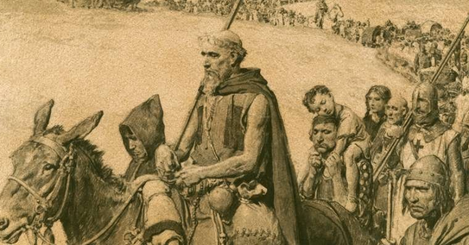
RESEARCH ACTIVITY
Q: Conduct research on Peter the Hermit. Who was he and why were people willing to follow him on a Crusade? What was the result?
Complete your research by creating a digital poster using Google Drive.

Slide 13
COMPREHENSION
Copy the following lists into your workbook. Then draw a line, or colour-code, the Christian “thing” with its matching Muslim equal.
Bible | Muslim
Jesus Christ | Allah
God | Mohammad
Amen | Mosque
Church | Koran
Christian | Allah-uh-akhbar

Slide 14
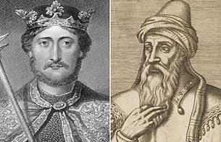
The Third Crusade
The Third Crusade is often considered the most famous of all the Crusades and mainly involved King Richard I and Saladin
King Richard I
Saladin

Slide 15
The Third Crusade
The rulers of Europe, King Richard I of England and King Phillip II of France, wanted to limit Saladin’s control of the Holy Land.
Manly people have come to believe that fighting between King Richard and Phillip allowed Saladin and the Muslims to recapture Jerusalem.
However, European rulers were able to limit Saladin’s control and did successfully negotiate a peace treaty that allow Christian pilgrims to visit the Holy Land.

Slide 16
RESEARCH ACTIVITY
So, was Saladin really a terrible person? Was Richard the LionHeart really a righteous king?
Both men are important figures of the Crusades and both men have been called heroes in their own cultures. What do you think?
Conduct research and create a biography poster of each man using Google Drive. Your aim is to discover the “Real King Richard” and the “Real Saladin”.

Slide 17
FILL IN THE BLANKS
What were the Crusades?
The _________ were a series of _______ where Christians and Muslims fought to control the Holy Land. J__________ is a holy place for Christians because many important events in the life of _________ happened there. It is holy to the Muslim religion, _________, too. Muslims believe their prophet, Mohammed, visited Heaven from there. Jerusalem and the surrounding area (what we call modern day Israel) was known as the ______ Land. The crusades dragged on and off for about ______ years. English knights and soldiers mainly fought in what is known as the Third Crusade between the years 1189 and 1192 under the king, ___________.
Crusades | wars | Jerusalem | Jesus
200 | Richard I | Holy | Islam

